Slide 1
Credit Card Fraud Detection
In a machine learning Way
By :-
Lokesh Soni
Asmita Goswami
Anshul Jain
Harsh Banshiwal

Slide 2
Objective
This project is to demonstrate the technical feasibility of a deep learning approach to design of an effective fraud detection system is necessary in order to reduce the losses incurred by the customers and financial companies. Research has been done on many models and methods to prevent and detect frauds.

Slide 3
Datasets and inputs
The data set contains 284,807 transactions. The mean value of all transactions is $88.35 while the largest transaction recorded in this data set amounts to $25,691.16.

Slide 4
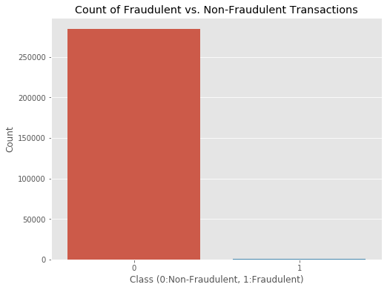
Count of Fraudulent vs Non-Fraudulent
Most transactions are non-fraudulent. In fact, 99.83% of the transactions in this data set were not fraudulent while only 0.17% were fraudulent.

Slide 5
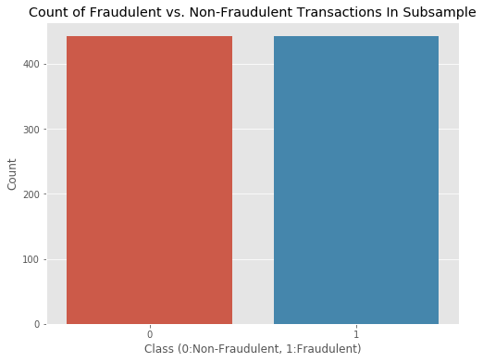
Data Preparation
To create our balanced training data set, I took all of the fraudulent transactions in our data set and counted them. Then, I randomly selected the same number of non-fraudulent transactions and concatenated the two. After shuffling this newly created data set, I decided to output the class distributions once more to visualize the difference.

Slide 6
Classification Algorithms
I first performed an 80/20 train-test split, splitting our balanced data set into two pieces. To avoid overfitting, I used the very common resampling technique of k-fold cross-validation. This simply means that you separate your training data into k parts (folds) and then fit your model on k-1 folds before making predictions for the kth hold-out fold. You then repeat this process for every single fold and average the resulting predictions.

Slide 7
Models Used
Logistic Regression
Linear Discriminant Analysis
K Nearest Neighbors (KNN)
Classification Trees
Support Vector Classifier
Random Forest Classifier
XGBoost Classifier

Slide 8
Results
Logistic Regression | 0.969935 (0.015809)
Linear Discriminant Analysis | 0.971031 (0.018132)
K Nearest Neighbors | 0.952787 (0.029242)
Classification Trees | 0.903660 (0.032223)
SVM | 0.966792 (0.015858)
Random Forest Classifier | 0.968781 (0.025161)
XGBoot Classifier | 0.964089 (0.022961)

